Slide 1

Starlink: Bridging
the Digital Divide
from the Stars
Lakshmanan
30-OCT-2024

Slide 2

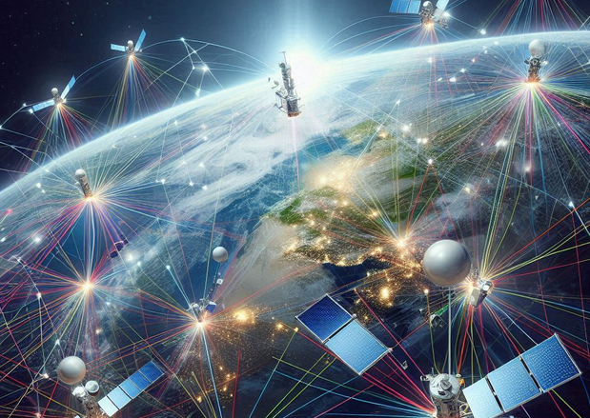
Introduction to Starlink:
Star link is a revolutionary satellite internet on stellation by SpaceX aimed at providing high-speed internet globally. This presentation explores how Starlink is addressing the digital divide and fostering connectivity in underserved areas. Join us on this journey from the stars to
your screens!
What is Starlink?
Starlink is a satellite internet service that utilizes a constellation of low Earth orbit satellites. This innovative network aims to provide affordable and high-speed internet access to users around the globe, especially in remote and rural locations where traditional broadband is.

Slide 3
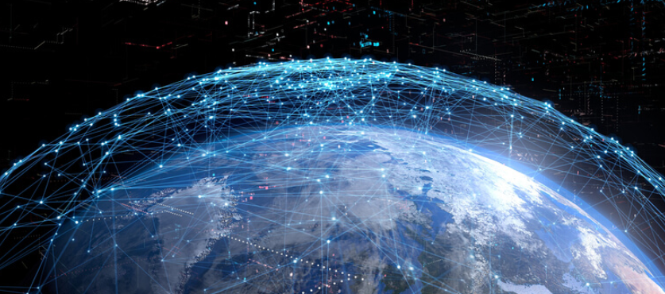

The Digital Divide:
The digital divide refers to the gap between those who have easy access to the internet and those who do not. This disparity affects education, healthcare, and economic opportunities, particularly in rural and developing regions. Starlink aims to close this gap by bringing internet access to everyone
Global Coverage:
Starlink's unique satellite network allow for global coverage, even in the most remote locations. With thousands of satellites in orbit, it can provide broadband internet access to users in areas previously deemed unreachable, thus expanding the digital
landscape.

Slide 4

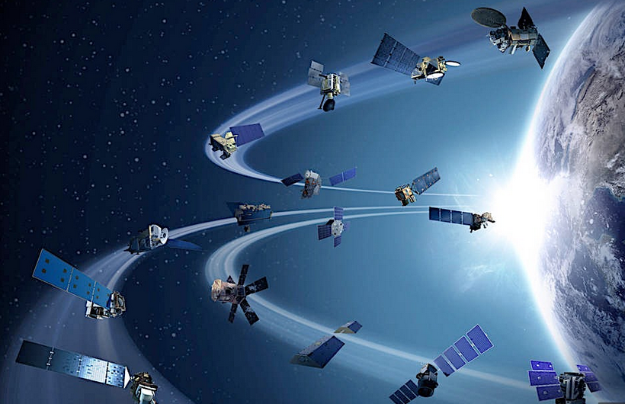
Impact on Education:
Access to reliable internet is crucial for modern education. Starlink enables students in remote areas to access online resources, participate in virtual classrooms, and connect with educators globally. This fosters equal opportunities for learning and growth, regardless of geographical barriers
Economic Opportunities:
Starlink's services can stimulate economic growth by enabling businesses in underserved areas to thrive. With reliable internet, entrepreneurs can reach global markets, access new technologies, and improve their overall productivity, thus
transforming local economies and creating jobs.

Slide 5

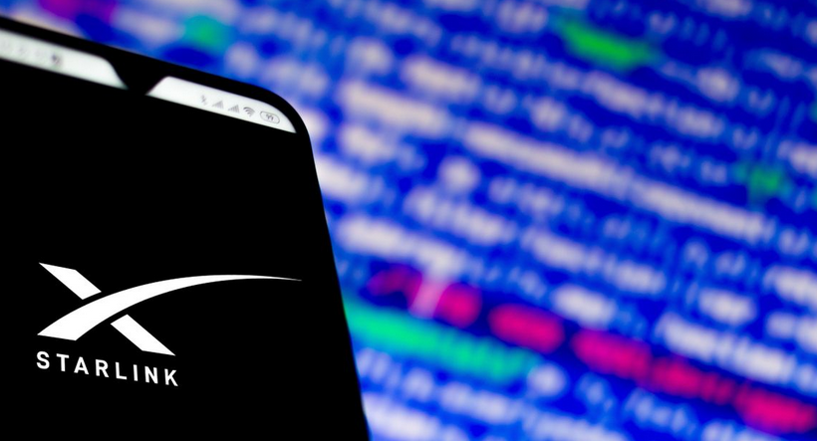
Challenges Ahead:
While Starlink offers immense potential, it faces challenges such as regulatory hurdles, space debris, and the need for sustainable practices. Addressing these issues is crucial for ensuring the long-term success of this innovative satellite internet service and its mission to connect the world.
Conclusion: A Bright Future:
Conclusion: A Bright Future Starlink is not just about internet access; it's about empowering individuals and communities. By bridging the digital divide, it paves the way for a more connected and inclusive world. Together, we can harness technology to create opportunities
for everyone, regardless of location

Slide 6


